Slide 1
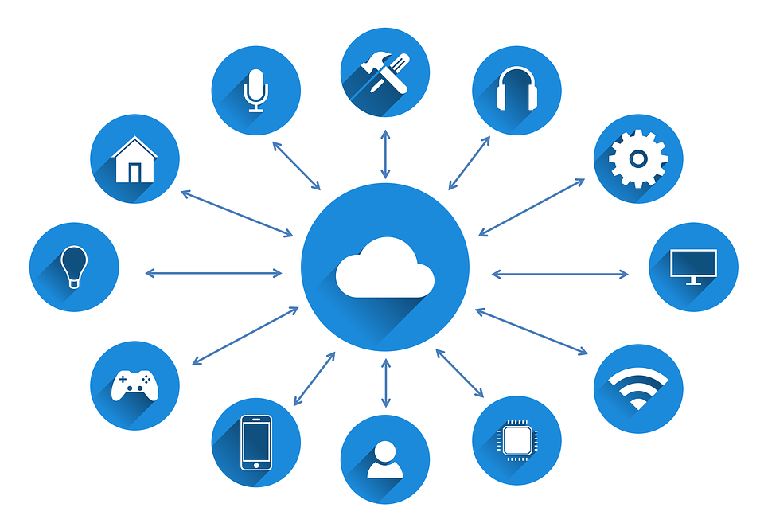
IoT Standards and Protocols
Frank Walsh

Slide 2
Agenda
IoT Characteristics
1
IoT challenges
2
IoT Protocol Stack?
3
Plan for the Future…
4
What you need to know.
5

Slide 3
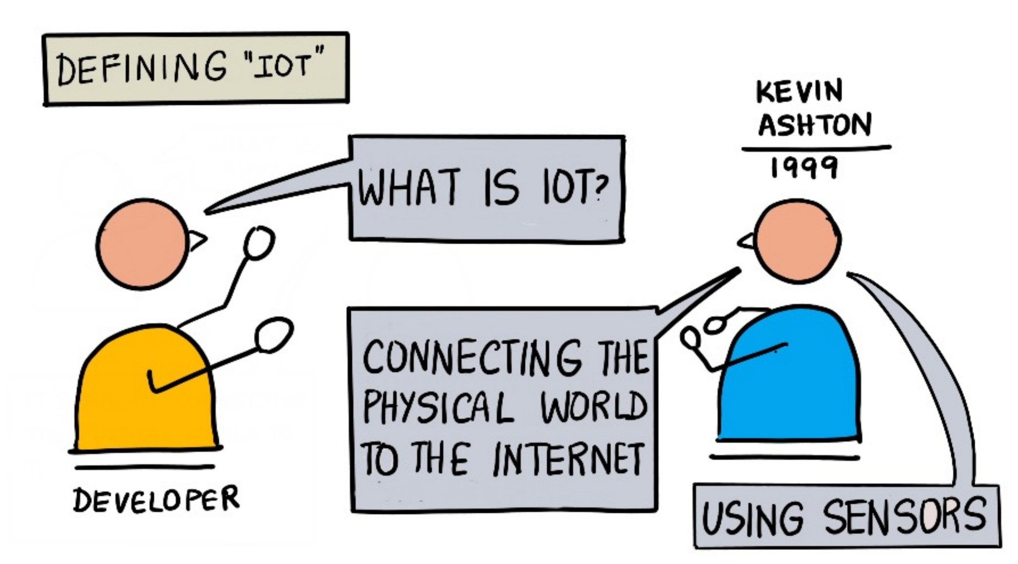
What’s IoT
Everyday objects with embedded technology to sense, connect, and communicate.
Empowered by:
Sensors, cheap and accessible compute power (microcontrollers), ubiquitous connectivity, networking and internet protocols.
Transforms isolated, passive things to connected things with compute power.
Collaborate to enable ground breaking applications.

Slide 4
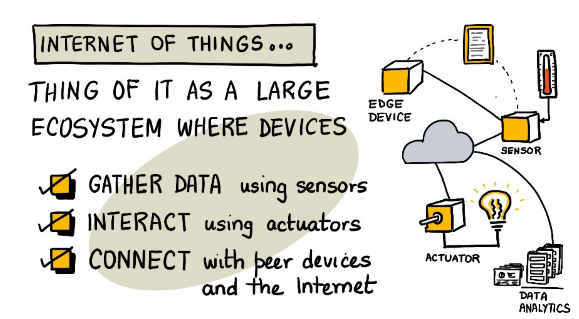

Slide 5
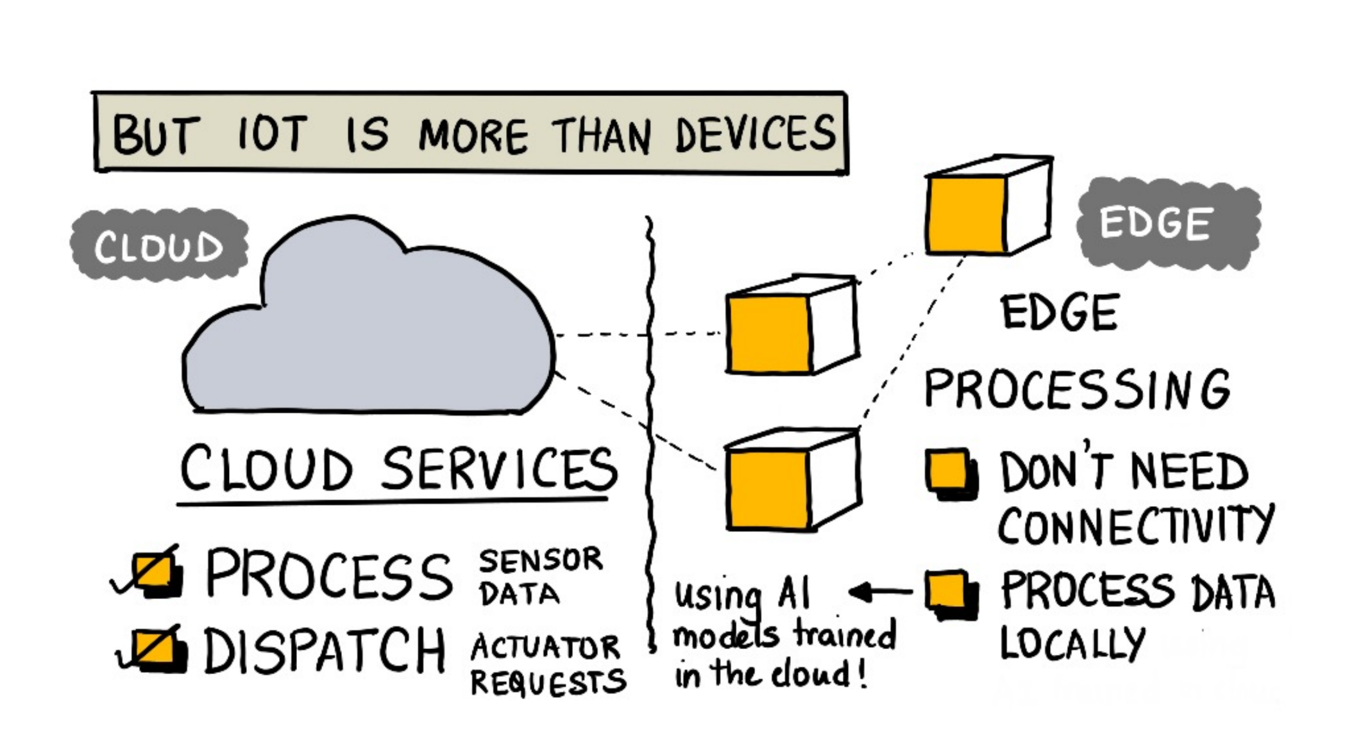

Slide 6
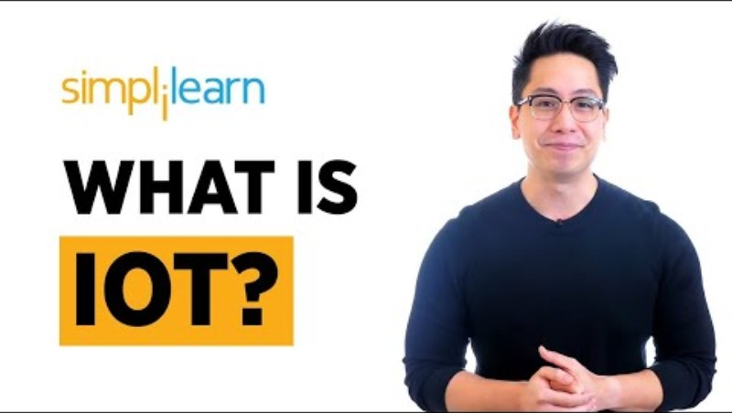
More characteristics…

Slide 7
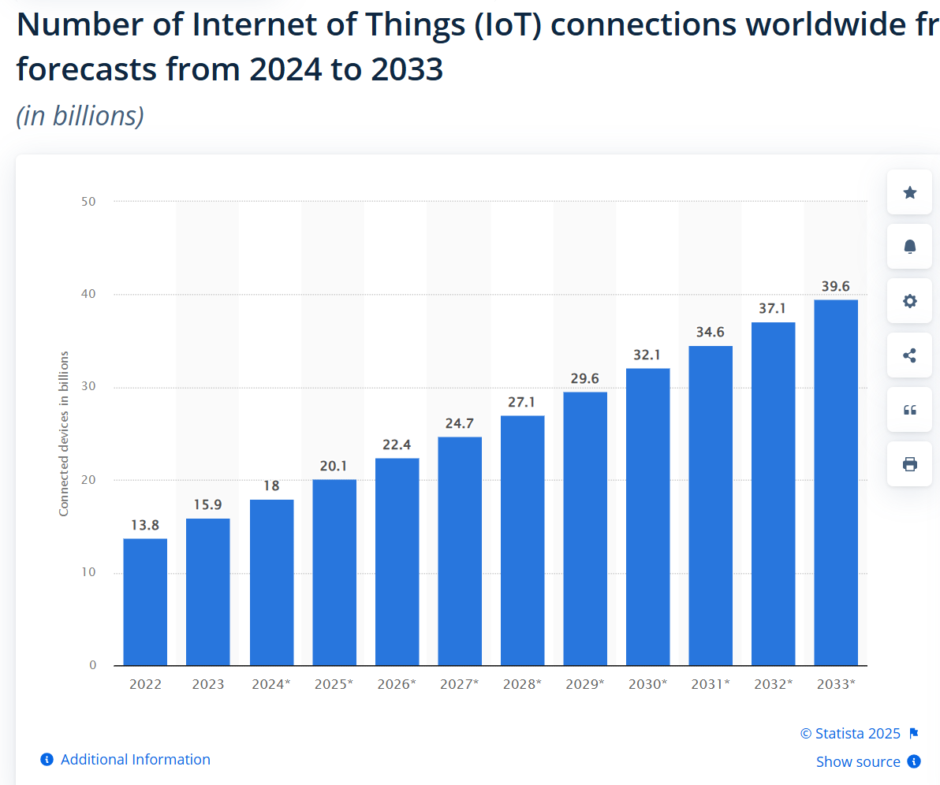
IoT Growth
20 Billion in 2025
80 ZB of data collected!
1 zettabyte = 1 trillion gigabytes (GB)
10²¹ bytes
Data is key to most IoT applications

Slide 8
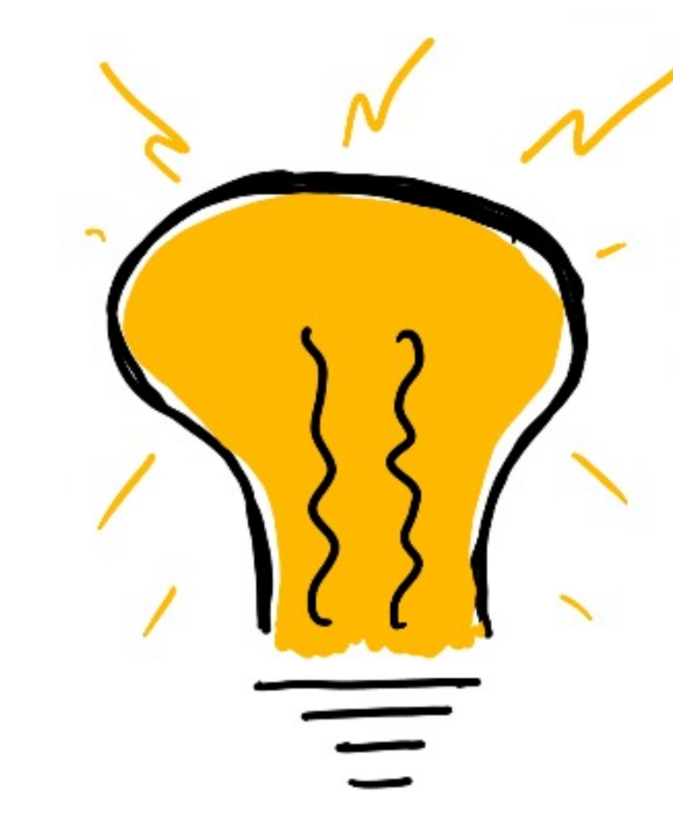
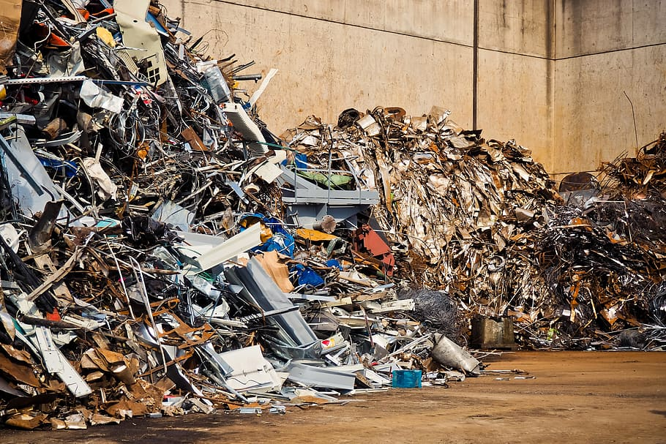
QI
Stands for Quite Interesting (I think so anyway!)
How much of the data created by IoT do we use?
Is there waste?
How can we minimise this?
Notes:
1. It’s estimated the less than 10% of the data generated by IoT devices is fully utilized. Yes. Example: Temp monitoring. Video monitoring in guards: While IoT generates vast amounts of data, we currently utilize less than 10% effectively, with most of it processed for immediate actions and discarded. Advances in edge computing, AI, and data integration are expected to improve utilization rates, enabling us to unlock the full potential of IoT-generated data. Examples: Smart Cities – Traffic cameras

Slide 9
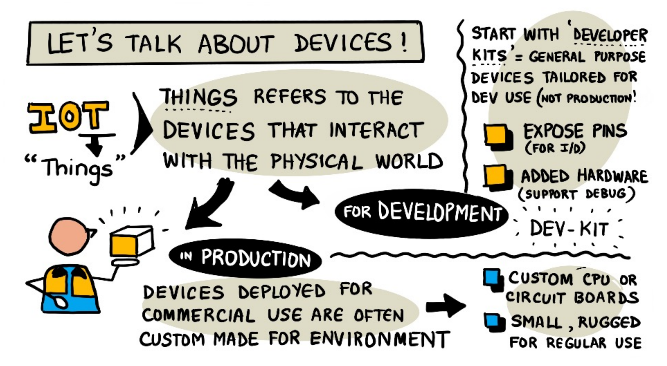
The “Thing” about IoT

Slide 10
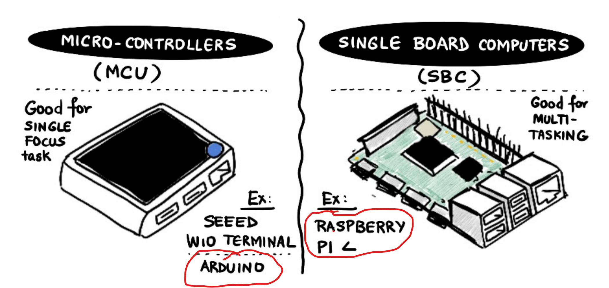
IoT Development
“kits” generally fall into 2 categories:

Slide 11
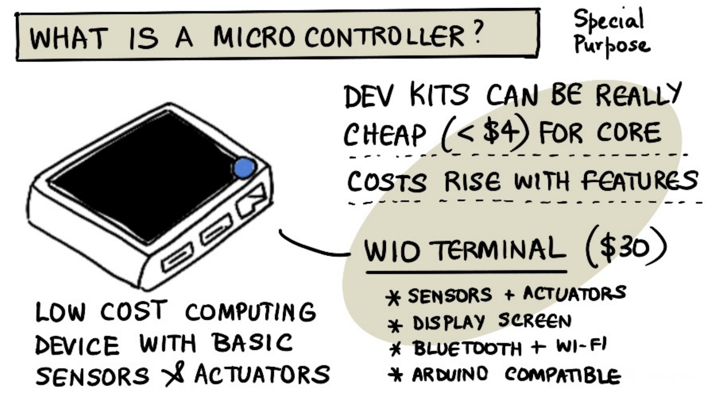

Slide 12
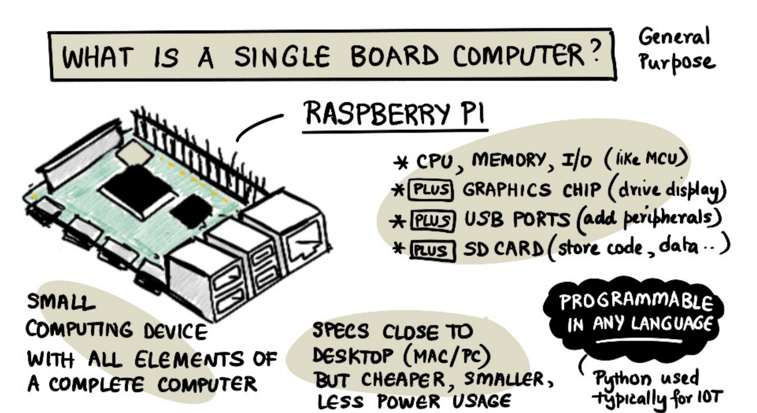

Slide 13
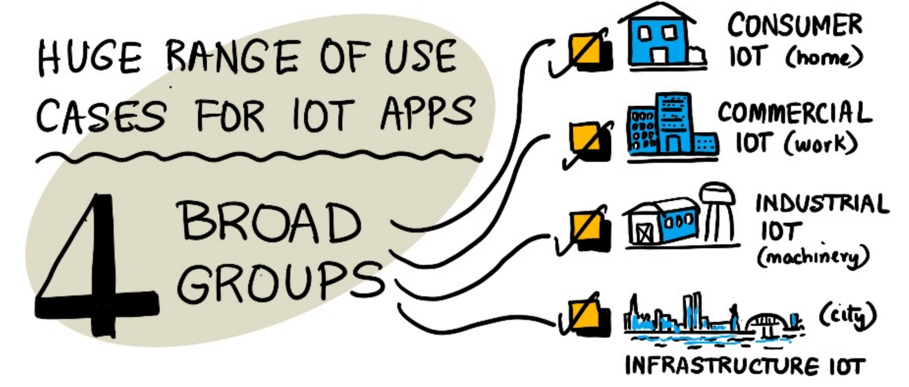
IoT Applications

Slide 14
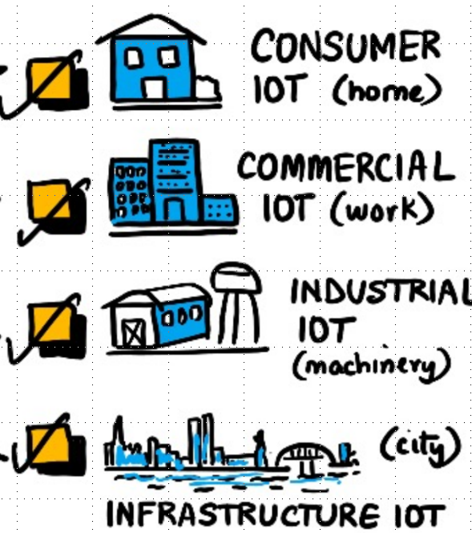
QI
For the 4 IoT areas, find one real-world example of each.
Do you use any Consumer IoT application?

Slide 15
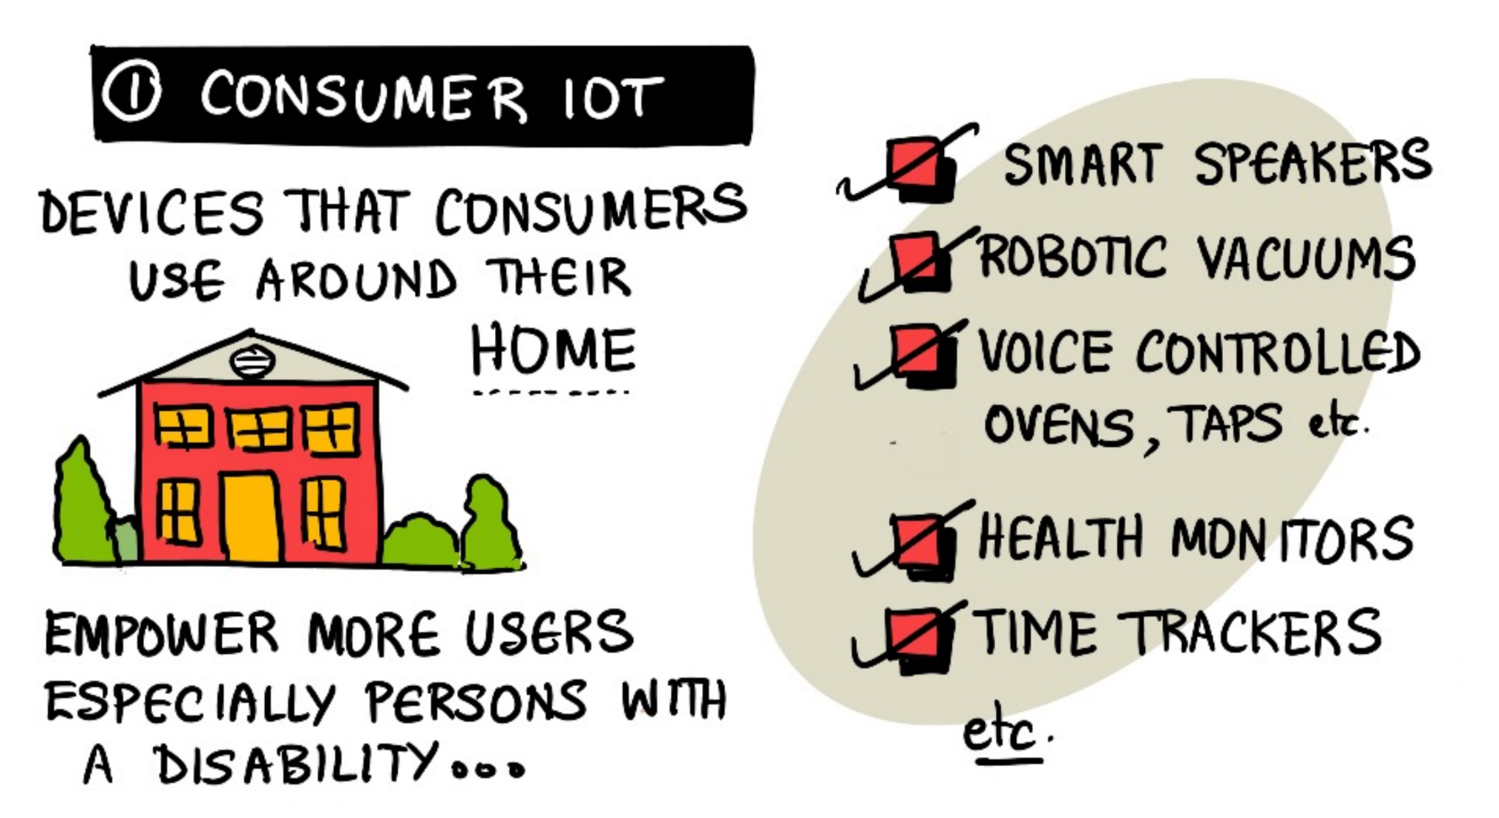

Slide 16
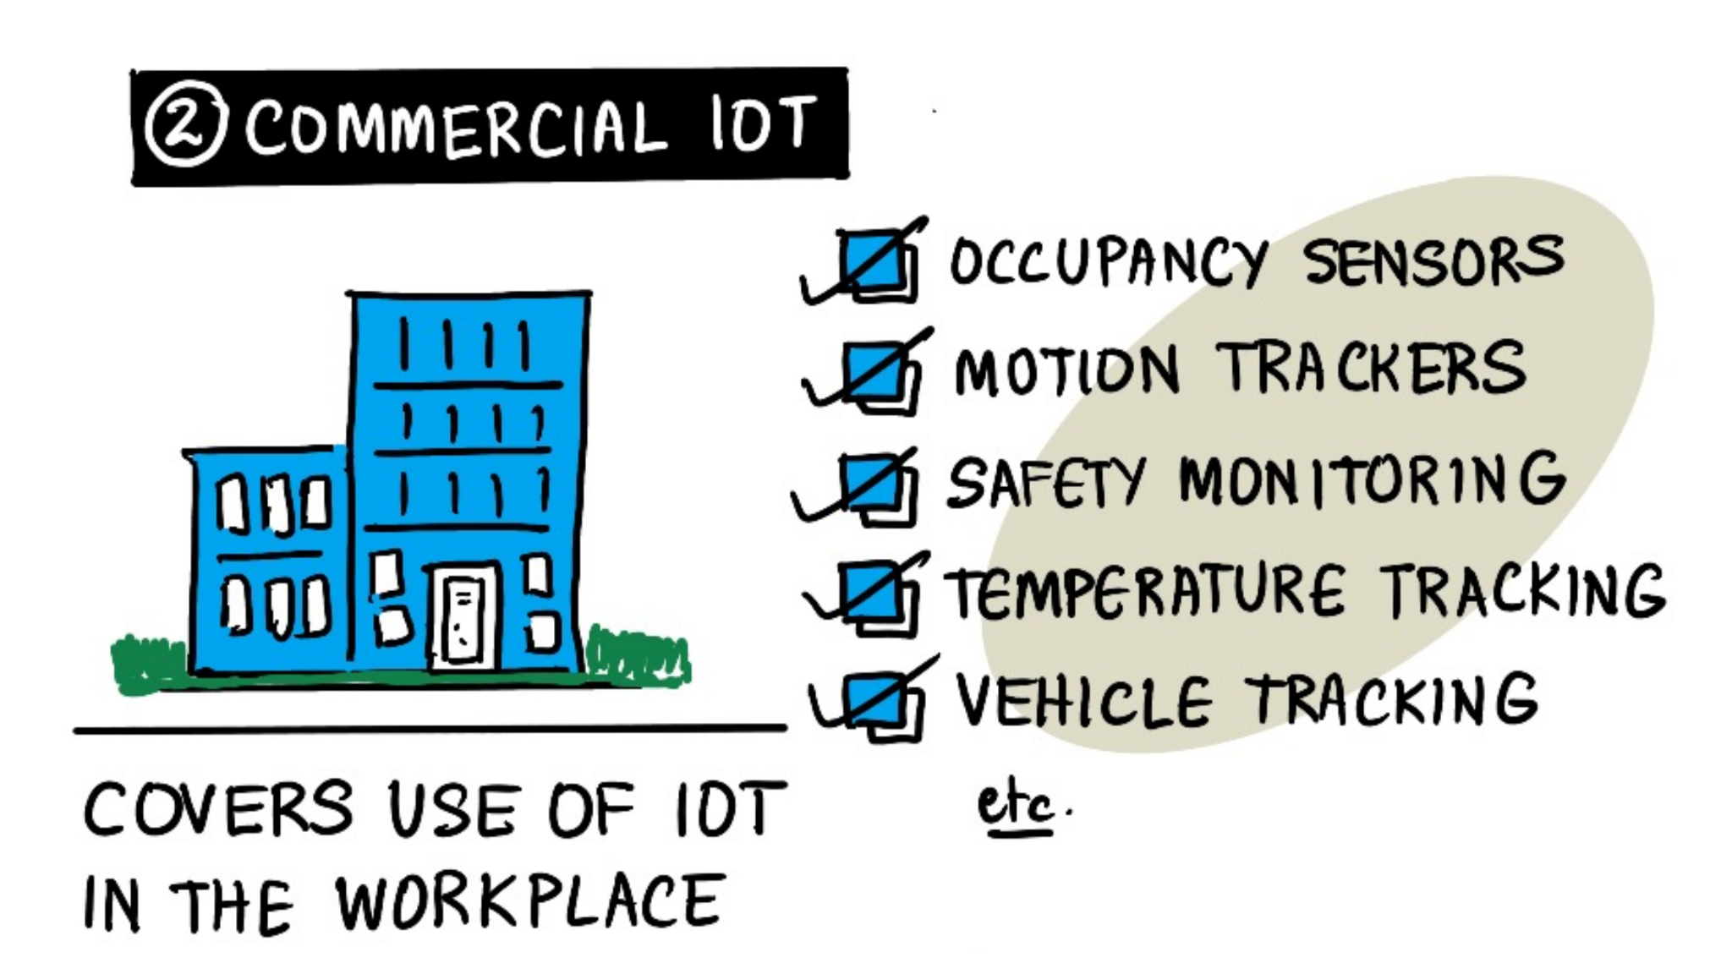

Slide 17
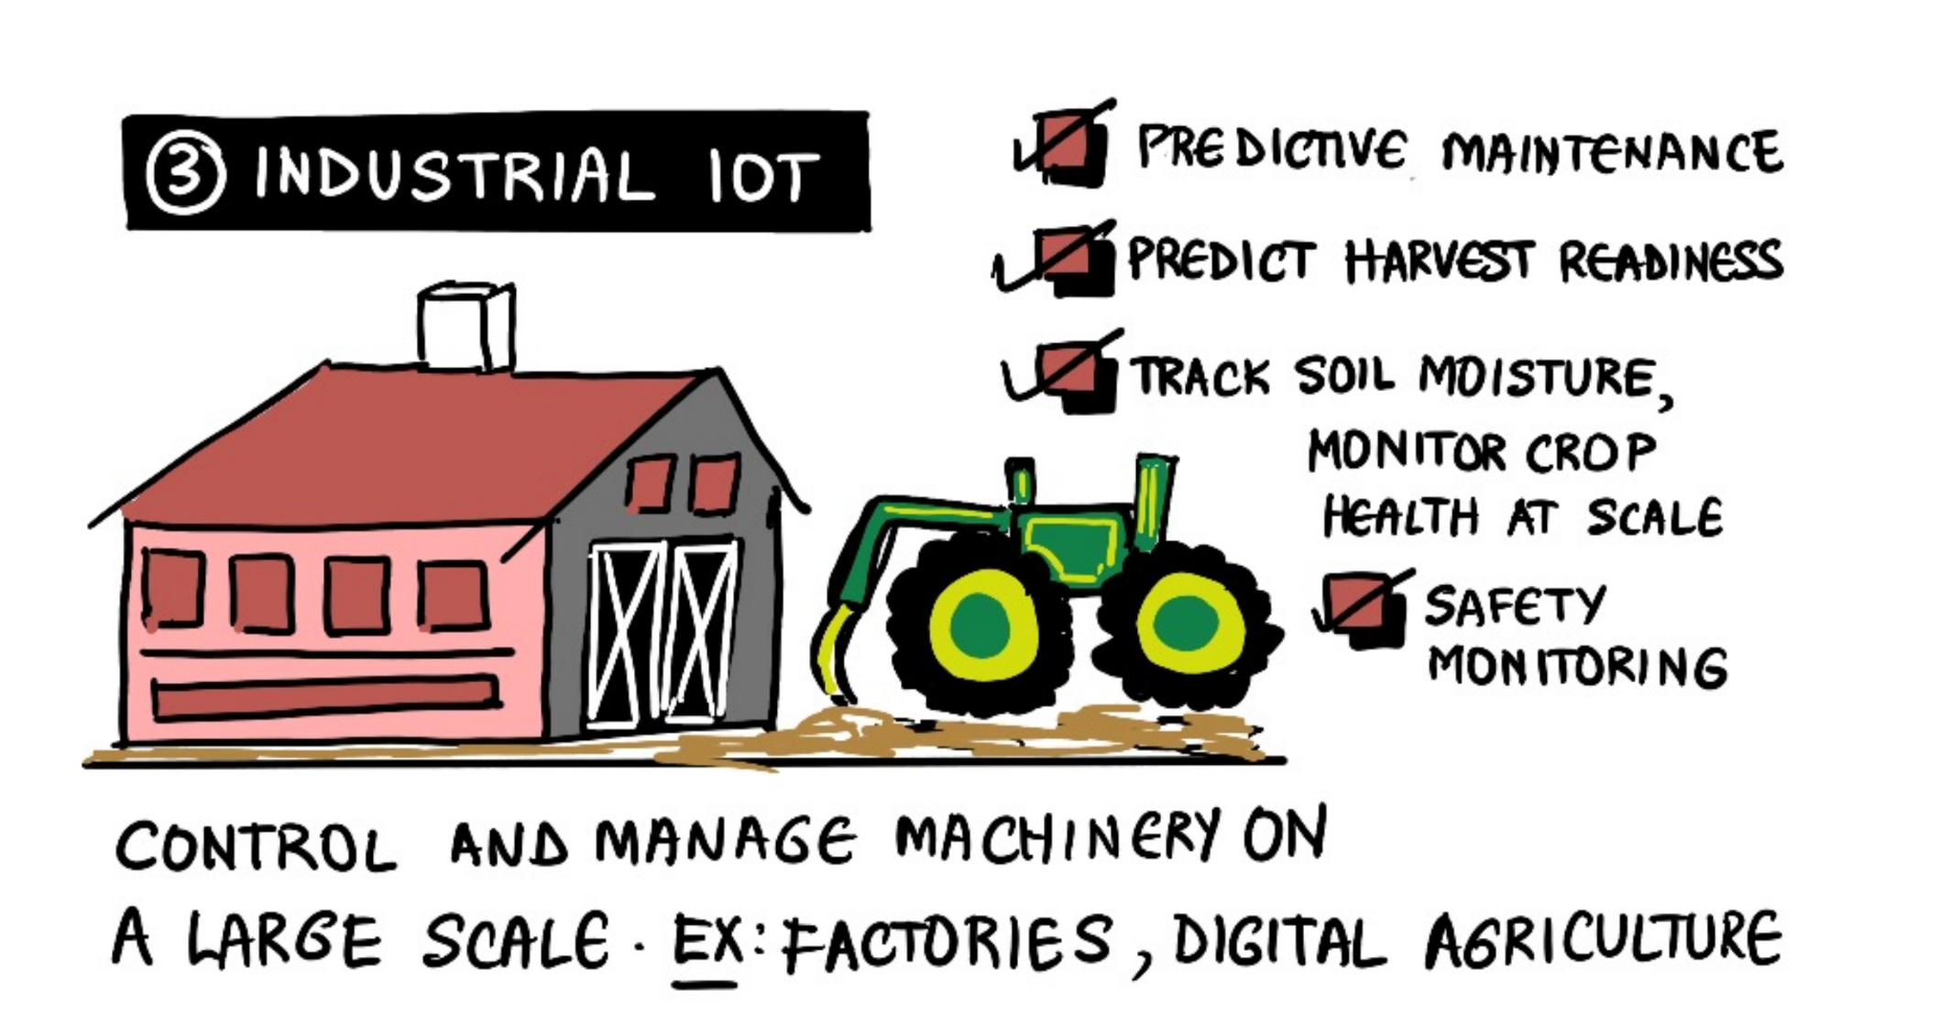

Slide 18
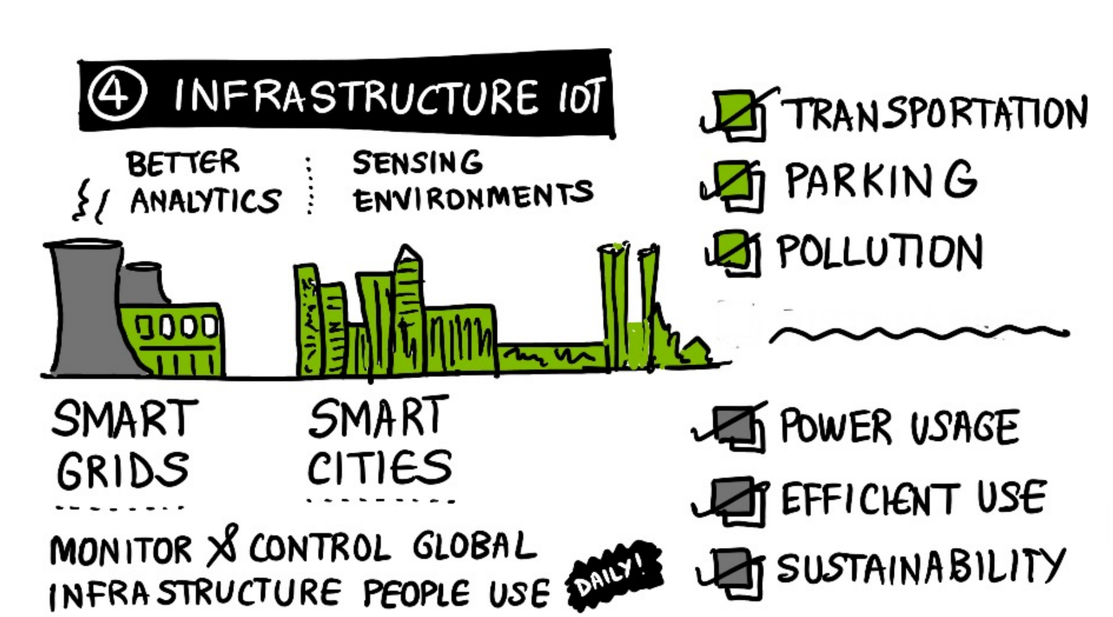

Slide 19
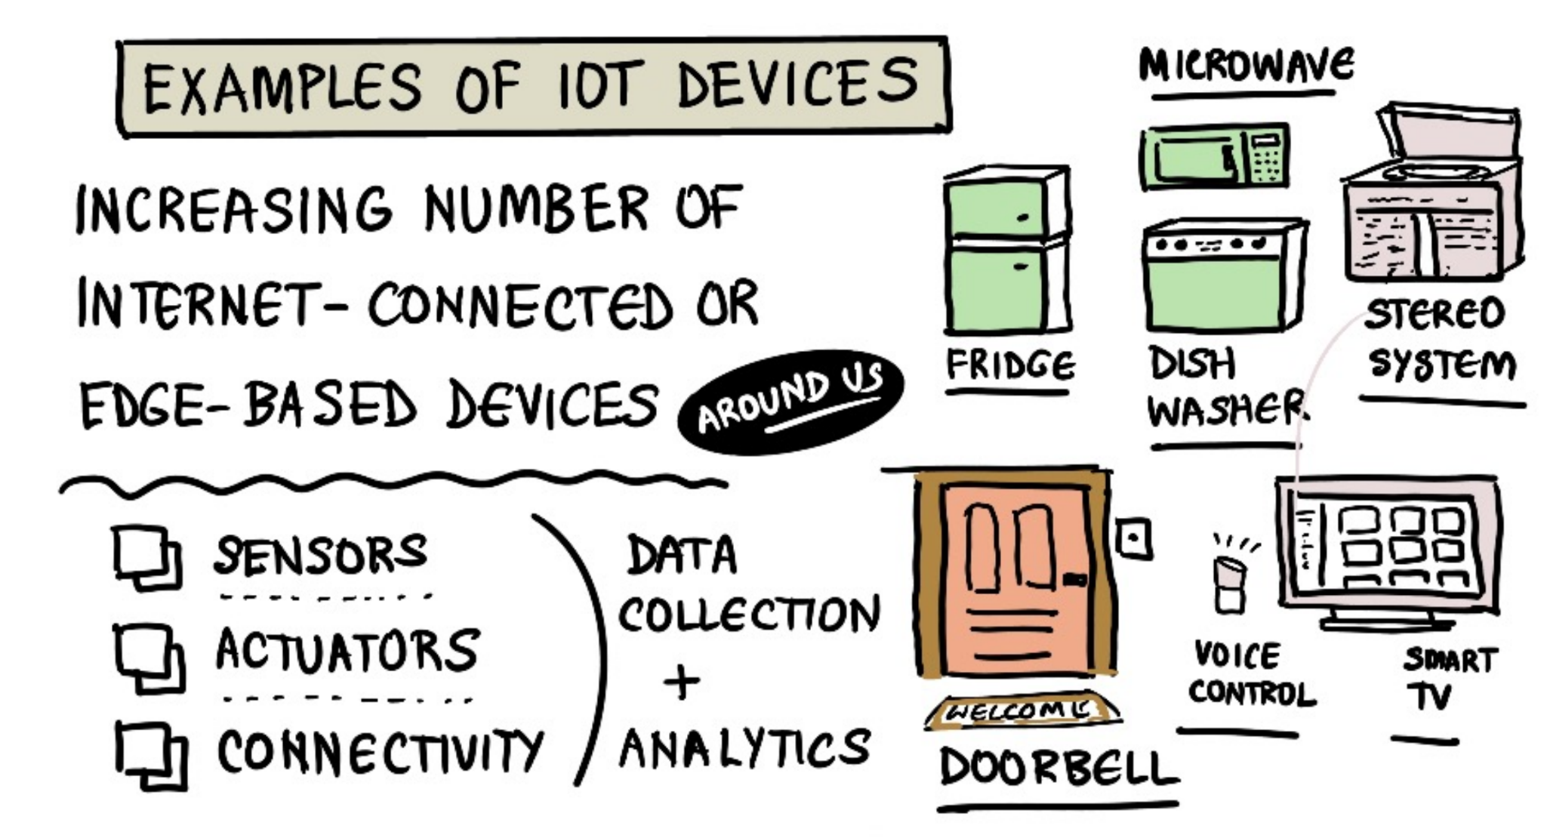

Slide 20
Fundamental parts for IoT
Devices
Send and Receive data
Network
Data is transmitted, routed
Edge Computing
Data is normalised, filtered,
Storage
Databases and data stores
Applications
Process and use data
People
Act and collaborate

Slide 21
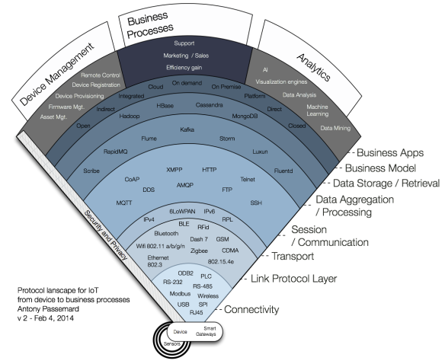
IoT Protocol Stack?
many protocols, many standards. Starting to consolidate
Some strong standards starting to emerge that address the IT/OT link
We will try to look a protocol in each layer, building a reference app that combines several.

Slide 22
IoT Stack Protocols.
Connectivity layer: The Actual physical connectors. RJ45 (usually for Ethernet), RS-232, ModBus, USB (as a connector type, not the communication protocol), SPI, ODB2 (in Cars), and Wireless (no connector!). Gateways can convert physical connectors into wireless.
Link Protocol: How do those device actually send the data. Ethernet 802.3, Wifi 802.11a/b/g/n, BlueTooth, BLE, ZigBee, Rfid, 6LoWPAN, 802.14.5e, CAN, SigFox, LoRa
Transport: IPv4 and IPv6
Session / Communication: MQTT, a subscribe and publish protocol that is used by Facebook for its mobile app, XMPP and AMQP , FTP, Telnet and SSH,
Data Aggregation / Processing: When device send data, lots of data, you need an end point to do something with it.
Data Storage / Retrieval: The realm of Big Data backend and NoSQL solutions.

Slide 23
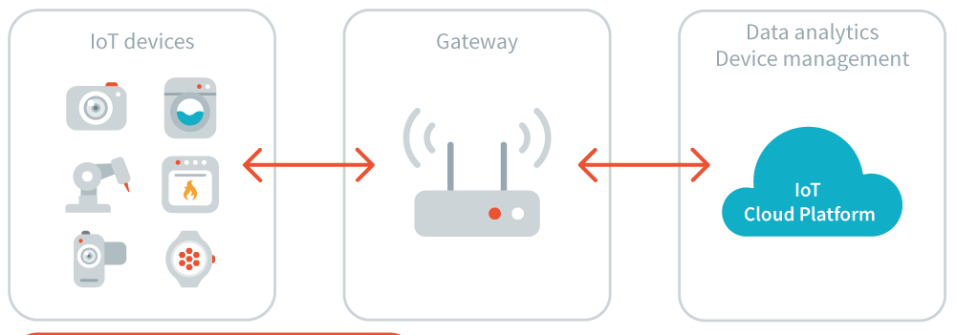
Plan for the Future…
Idea is to explore prototypical IoT solutions which uses open standards and protocols to integrates IT and OT.
Project style approach
Have a working artefact that demonstrates skills from other modules on the course.
Use things
Raspberry Pi + Sensors, SmartPhone
Use languages
Python, Javascript, Shell Scripting
Use cloud platforms
Thingspeak, Blynk

Slide 24

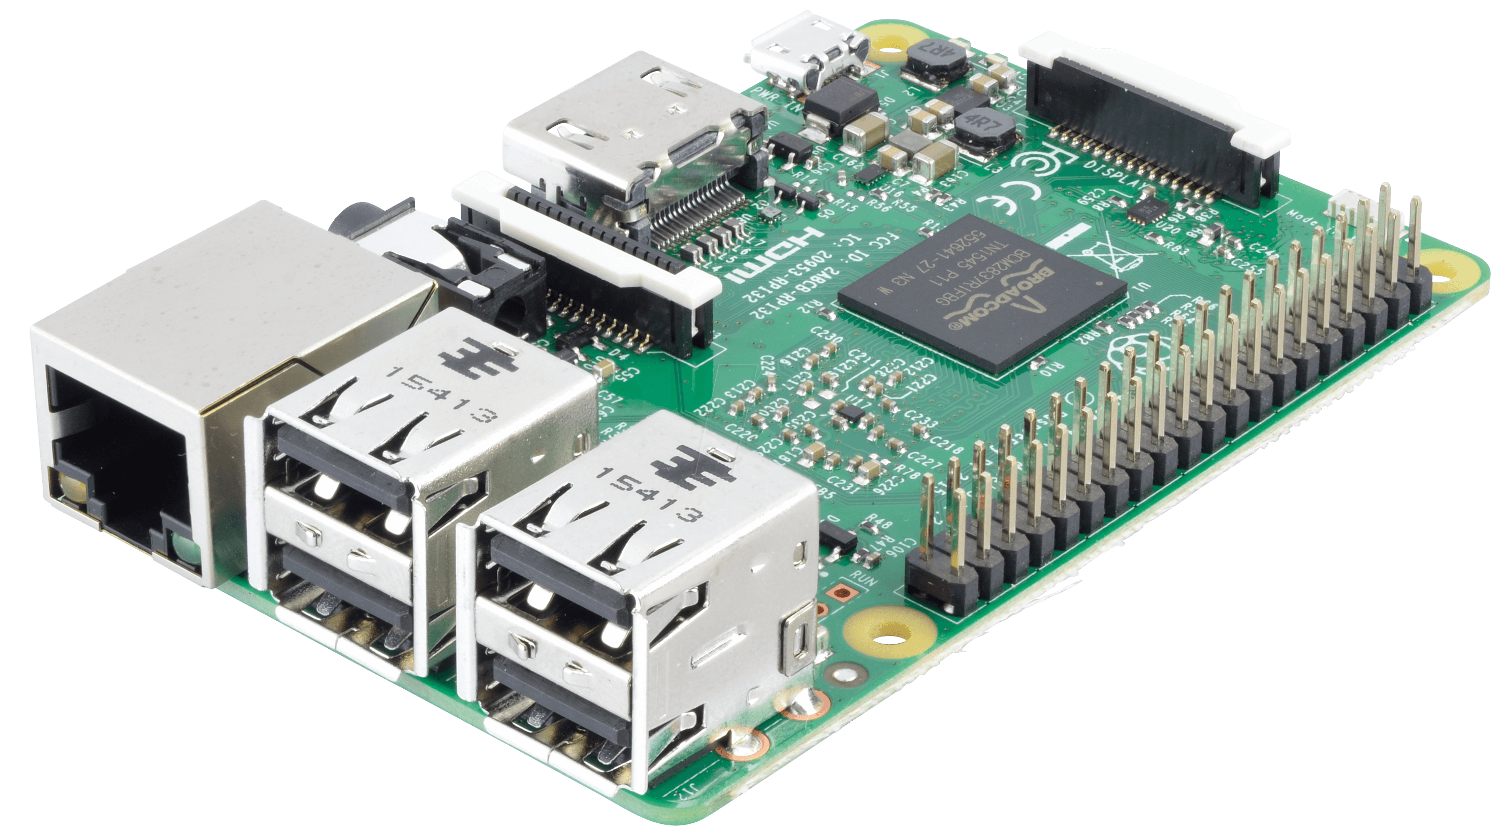

What You’ll need
This Photo by Unknown Author is licensed under CC BY-SA-NC
This Photo by Unknown Author is licensed under CC BY-NC
VS Code
Access to Moodle
Raspberry Pi (pending)
Sensors and Acutators(pending)
Conterfit (See lab)
This Photo by Unknown Author is licensed under CC BY

